Slide 1
Homework 1
COSE331 Computer Graphics

Slide 2
Goal
Setting up Android Studio development environment
Filling in some lines in the vertex shader
Vertex position
Vertex normal
Texture coordinates
Filling in lines in the functions of the scene class in GL program

Slide 3
Android Studio
Android Studio is the official integrated development environment (IDE) for the Android platform.
Android Studio can be downloaded from the official website. [link]

Slide 4
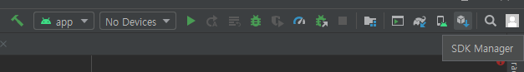
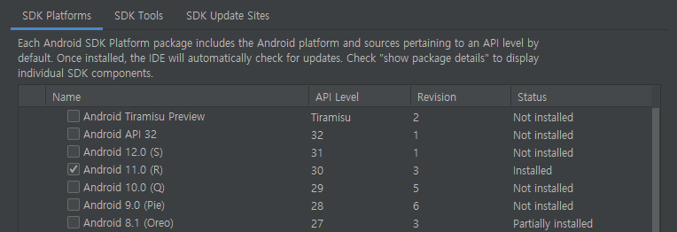
Android SDK
Android SDK can be installed through the SDK Manager in Android Studio.
Use SDK API level 30

Slide 5
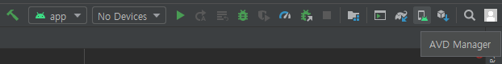
Android SDK
You may need to install additional platforms to try USB debugging on your smartphone.
Or you can use Android Virtual Device (AVD).
To use AVD, you need to enable hardware virtualization technology (shown as VT-x or SVM) in BIOS settings.

Slide 6
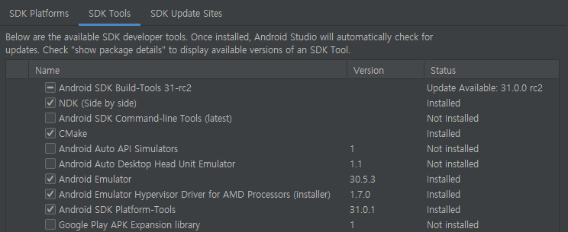
Android SDK
To use C++ native language on Android, you need to install the following tools.
CMake
NDK (Use version 19.2.5345600)

Slide 7
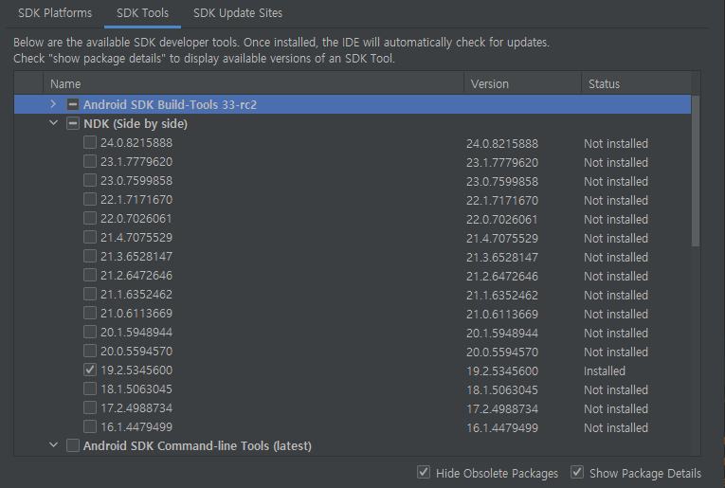
Android SDK
Use NDK version 19.2.5345600.

Slide 8
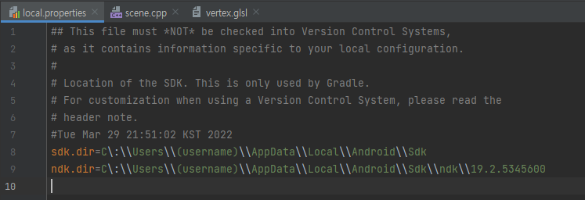
Gradle Sync
Before doing homework, you have to modify local.properties file.
Change (username) of ndk.dir and sdk.dir to your PC username.
Use the following path for MacOS device.
sdk.dir=/Users/(username)/Library/Android/sdk
ndk.dir=/Users/(username)/Library/Android/sdk/ndk/19.2.5345600

Slide 9
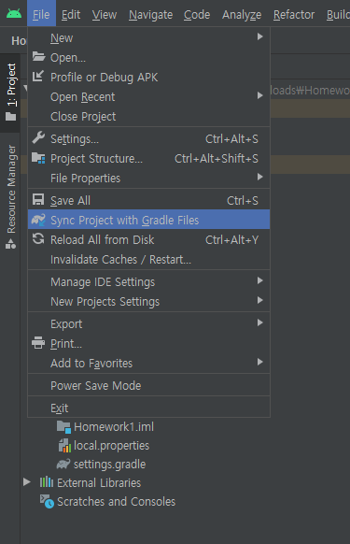
Gradle Sync
After modifying, sync project with gradle files.
Files – Sync Project with Gradle Files

Slide 10
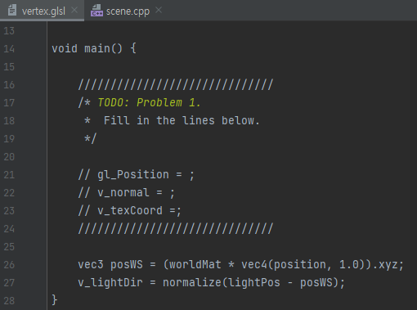
Problem 1
Fill in some lines in the vertex shader.
app/src/main/assets/vertex.glsl

Slide 11
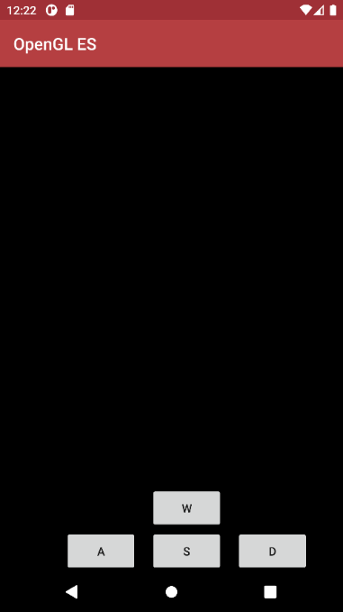
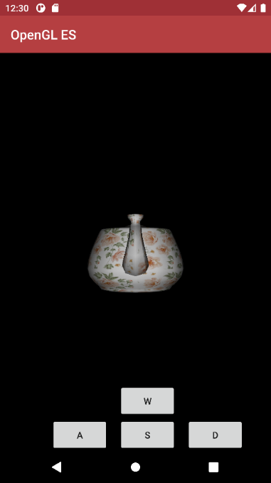
Problem 1
The clip-space vertex position must be calculated.
The world-space vertex normal must be calculated accurately considering non-uniform scaling.
Note that the lighting will look weird if vertex normals are incorrect.
The texture coordinates will be sent to the rasterizer stage with no change.

Slide 12
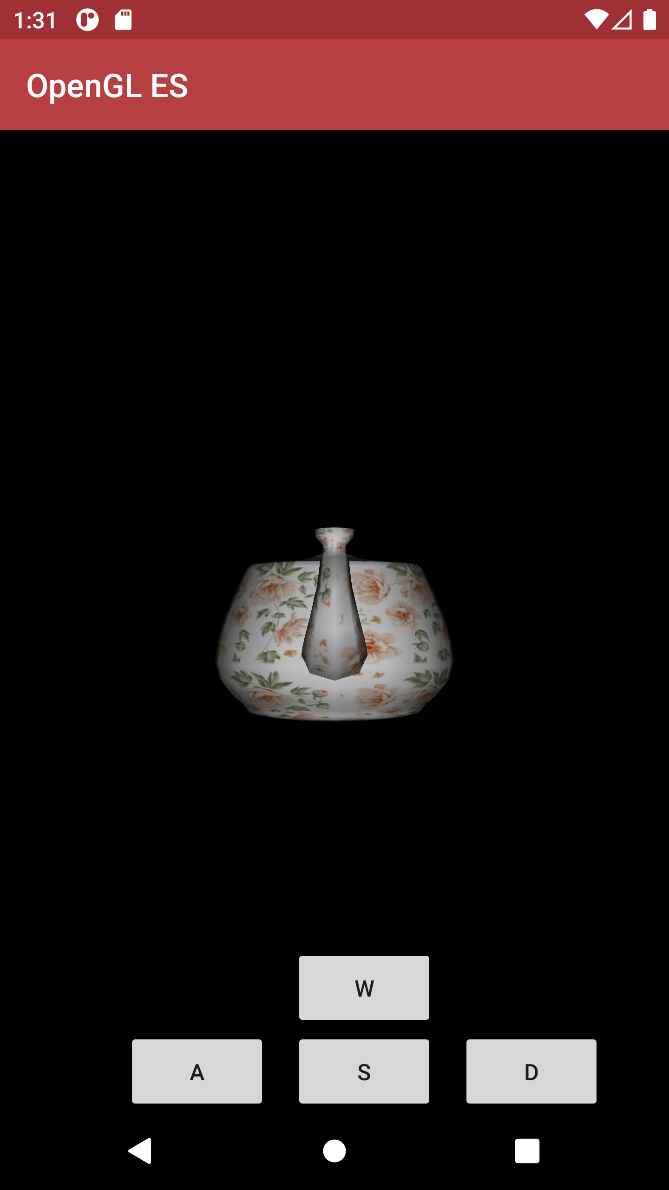
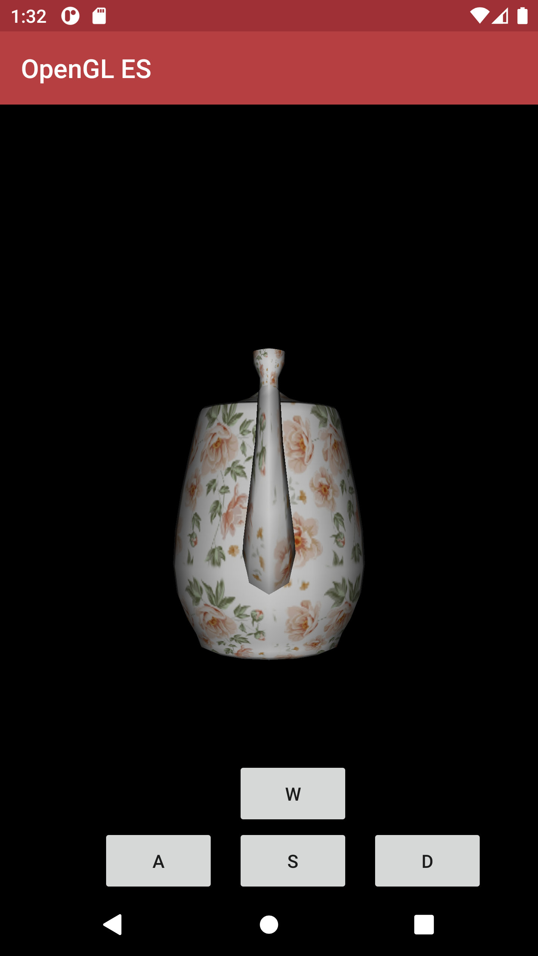
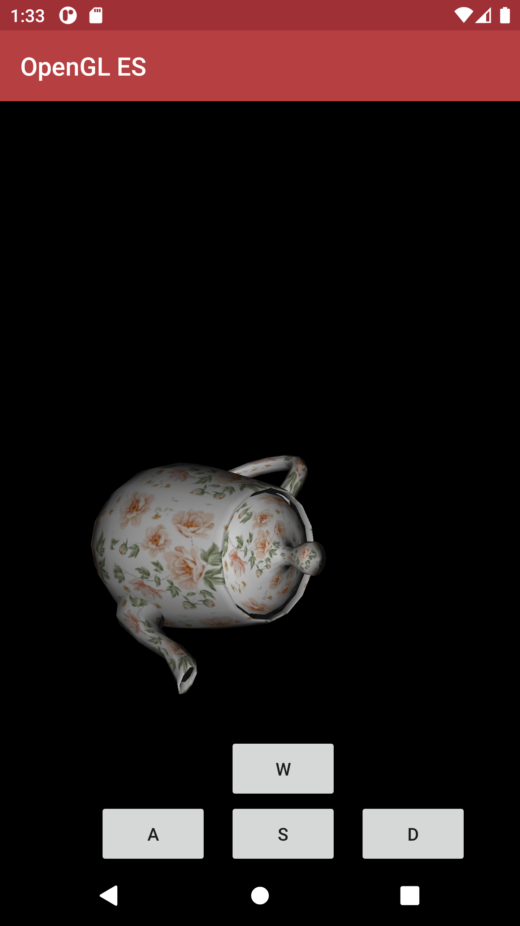
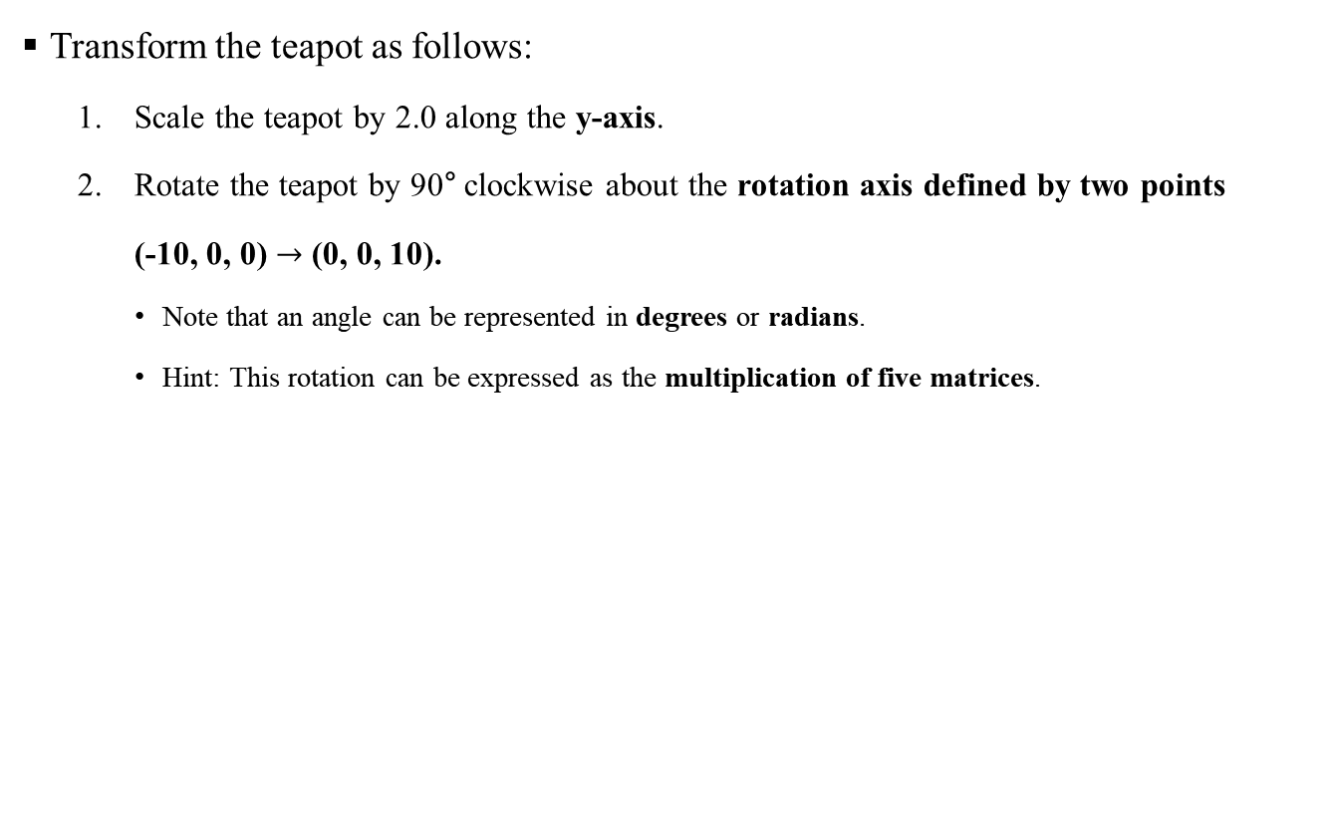
Problem 2
Transform the teapot as follows:
Scale the teapot by 2.0 along the y-axis.
Rotate the teapot by 90° clockwise about the rotation axis defined by two points
(-10, 0, 0) $→$ (0, 0, 10).
Note that an angle can be represented in degrees or radians.
Hint: This rotation can be expressed as the multiplication of five matrices.

Slide 13
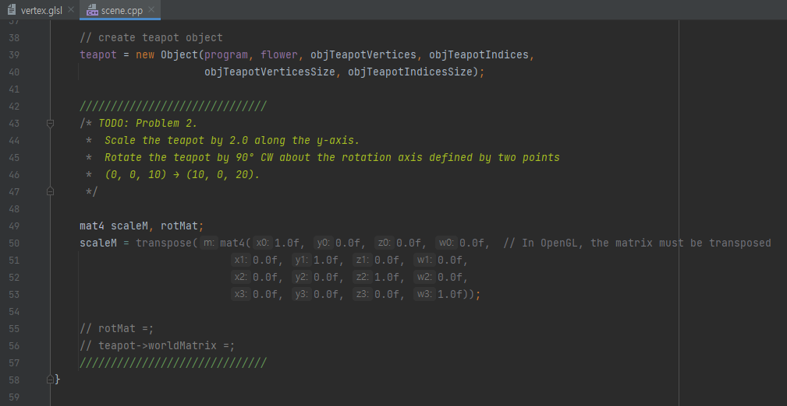
Problem 2
Fill in some lines in Scene::setup(…).
app/src/main/cpp/scene.cpp

Slide 14
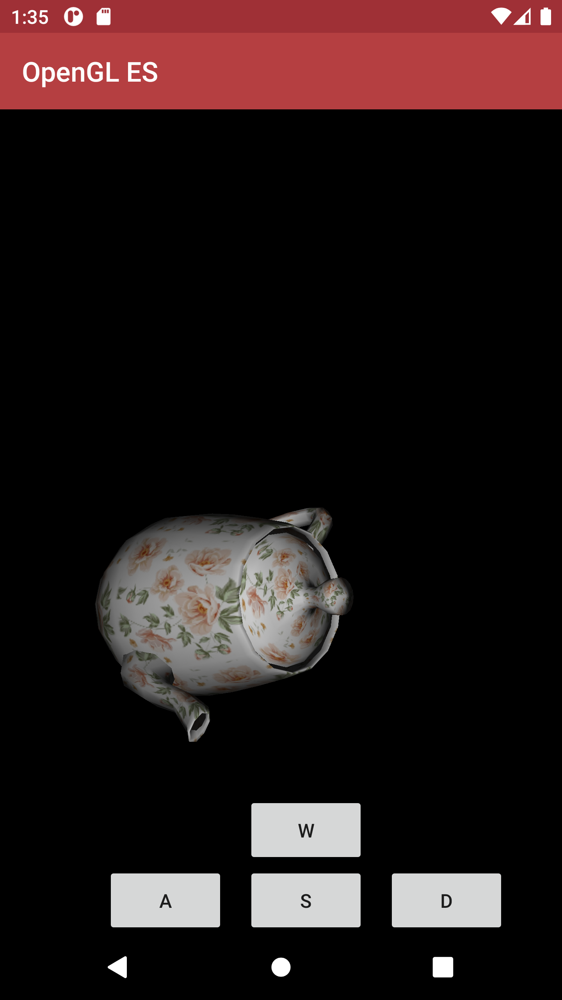
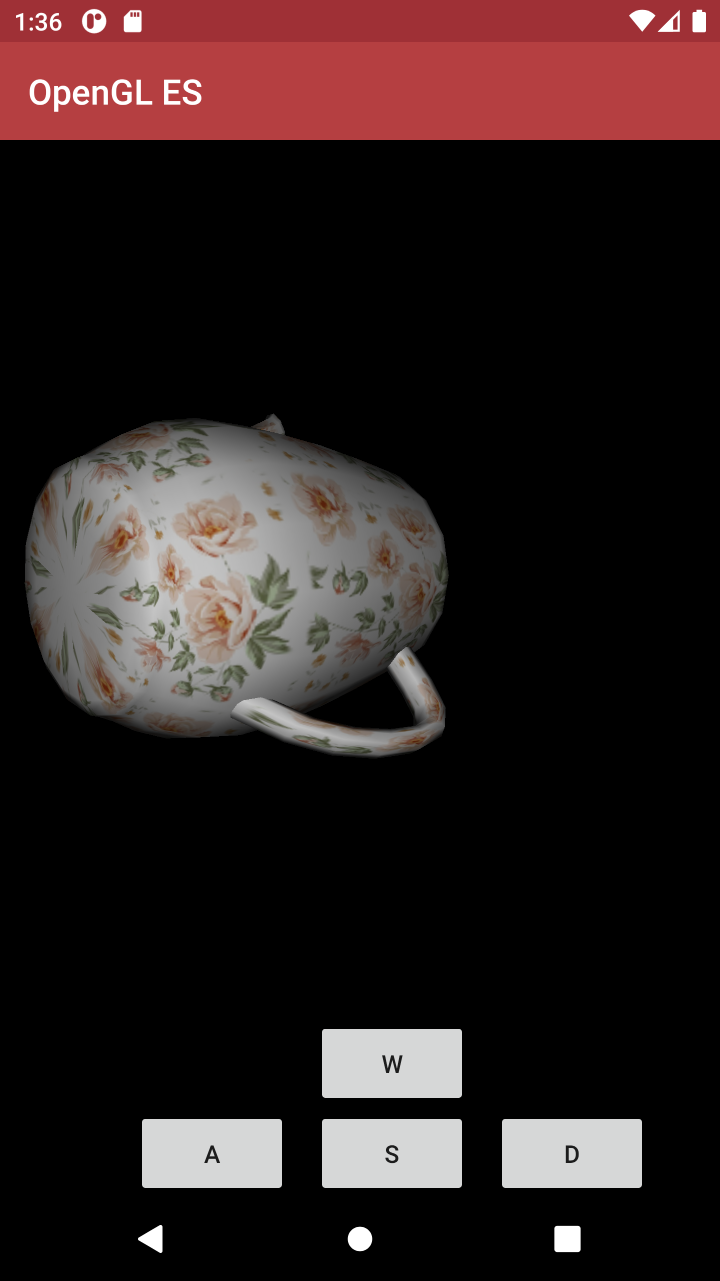
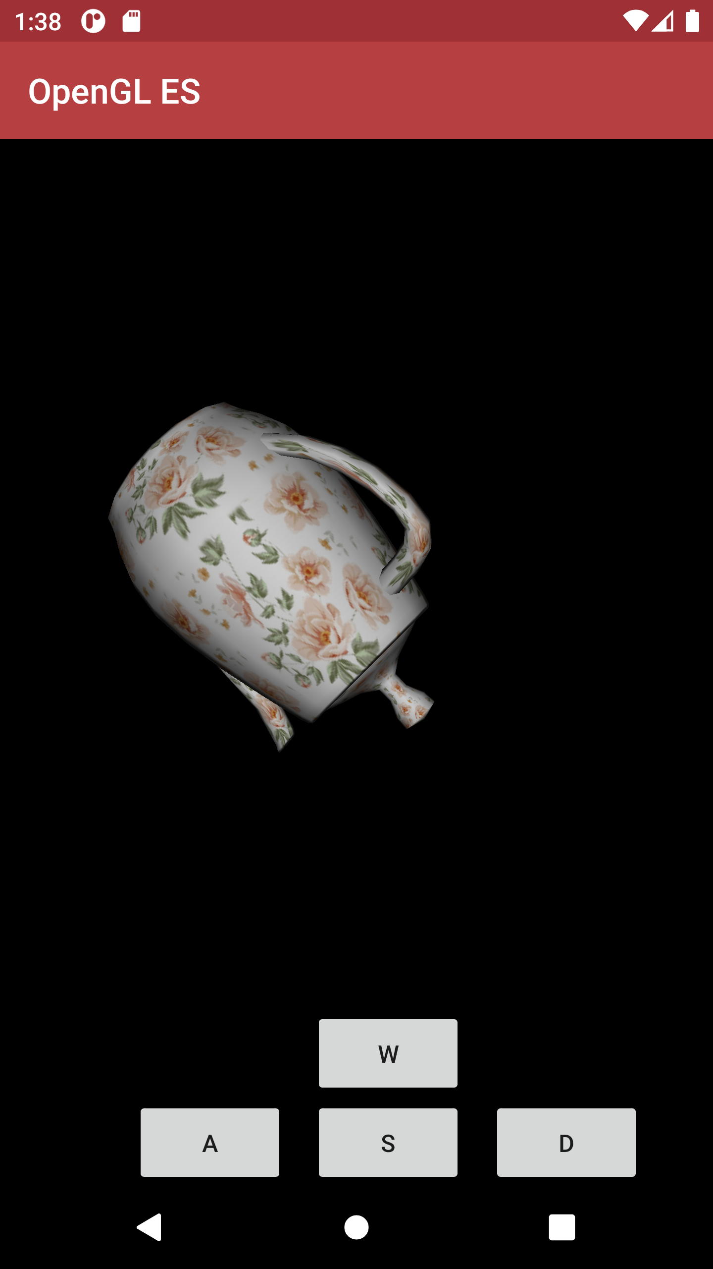
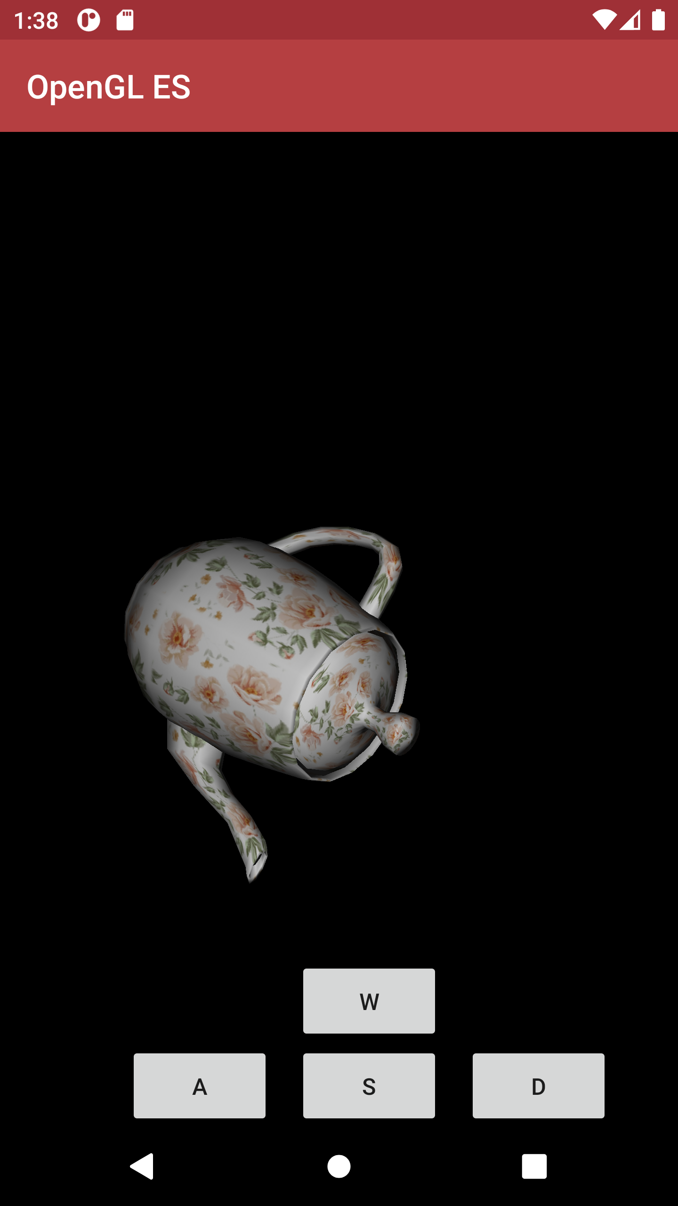
Problem 3
Rotate the teapot about the z-axis.

Slide 15
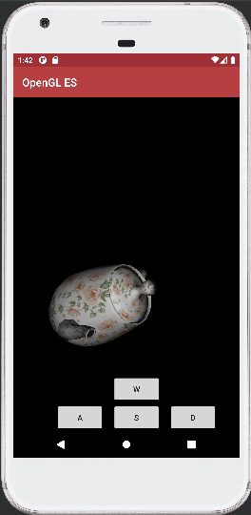
Problem 3

Slide 16
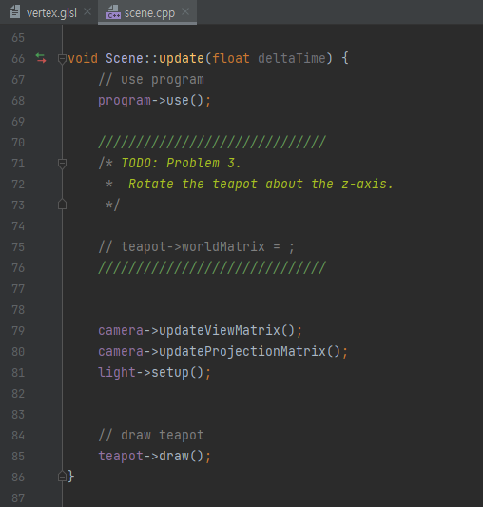
Problem 3
Fill a line in Scene::update(float deltaTime).
app/src/main/cpp/scene.cpp
deltaTime is given in seconds

Slide 17
Problem 4
Complete camera movement and rotation.
Move camera along u, v, n in view matrix when buttons are pressed.
Rotate camera when the screen is dragged.

Slide 18
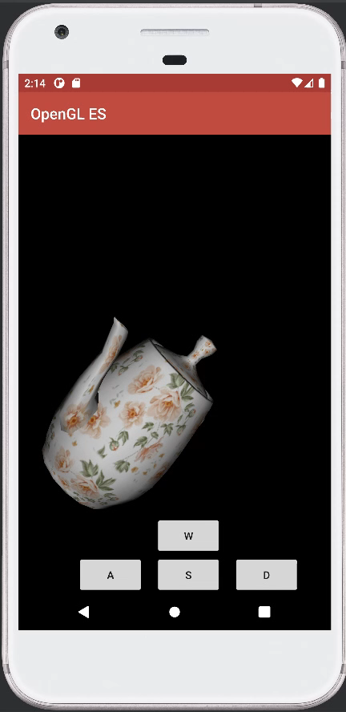
Problem 4

Slide 19
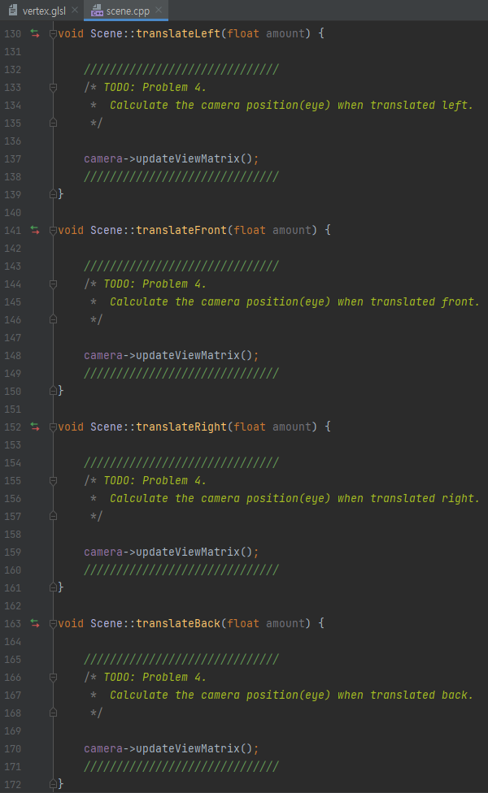
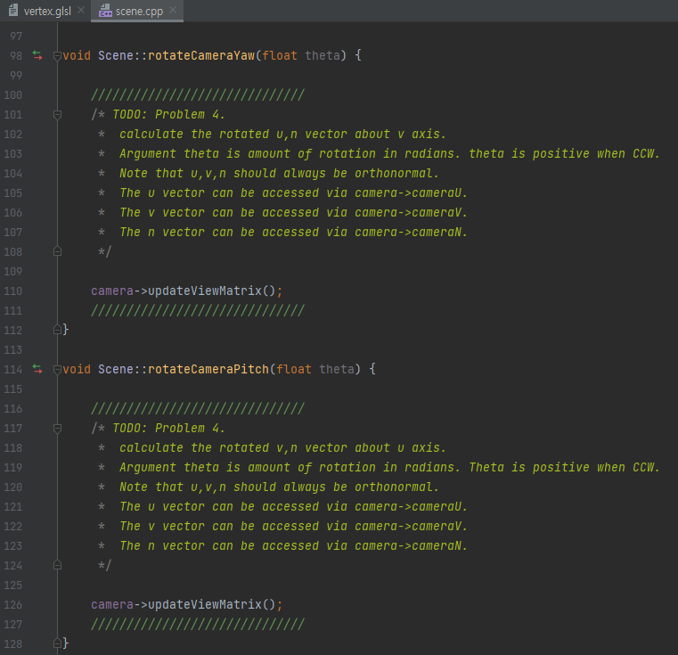
Problem 4
Fill in some lines in scene.cpp.
app/src/main/cpp/scene.cpp

Slide 20
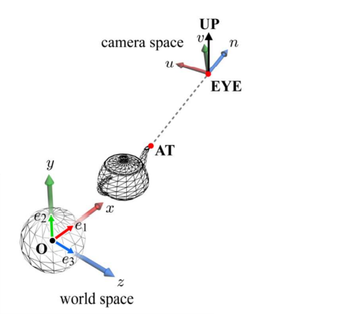
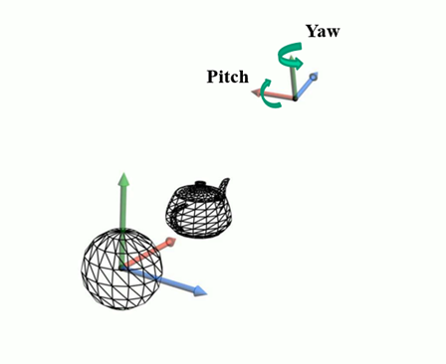
Problem 4
Functions to fill in:
rotateCameraYaw(float theta)
Horizontal rotation
rotateCameraPitch(float theta)
Vertical rotation
translateLeft(float amount)
translateFront(float amount)
translateRight(float amount)
translateBack(float amount)

Slide 21
GLM Library
You may want to use some glm functions.
glm::cross(…)
glm::normalize(…)
glm::translate(…)
glm::rotate(…)
…

Slide 22
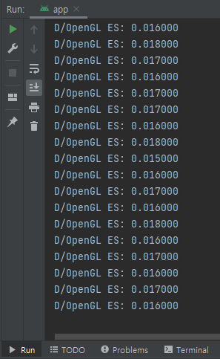
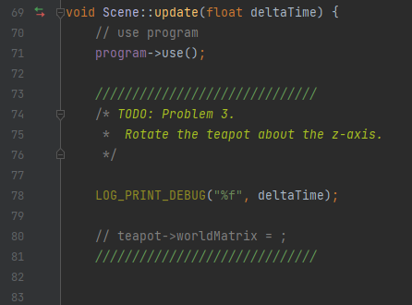
Debugging
You can use LOG_PRINT_DEBUG() for debugging purposes
example)

Slide 23
Submission
Deadline
April 13 (Wed) 14:00
Submission files ({student_id}_{name}.zip)
Vertex shader file (app/src/main/assets/vertex.glsl)
Scene class file (app/src/main/cpp/scene.cpp)
Submission to Blackboard
Contact
TA email: 2022.CG.TA@gmail.com

